Slide 1
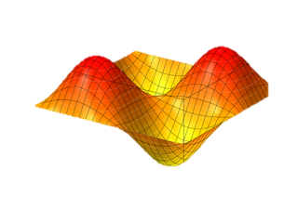




When Fourier meet Deep Learning Complex Number meet Ensemble Method
By : LAM Ho Sang
香 港 城 市 大 學
City University of Hong Kong
Ver 5.0, Copyright, Aug 2022

Slide 2

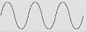

- Wavefront is the surface of a propagating wave. - Complex number representation is necessary, $ae^{jθ}$, where $Ɵ$ is a function of space and time.
Wavefront

Slide 3
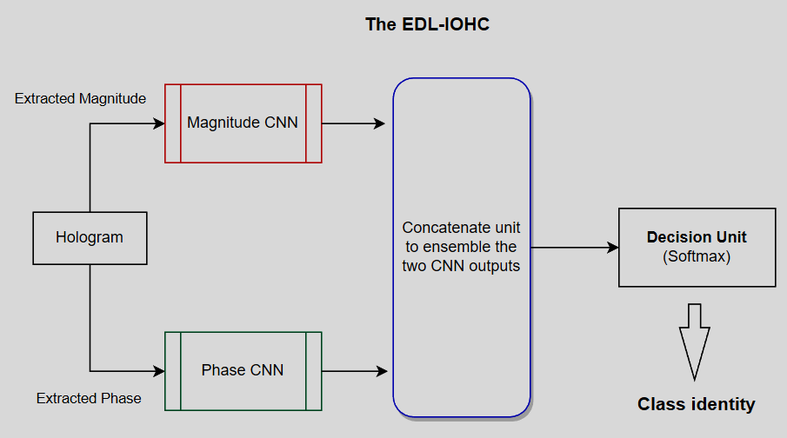
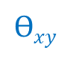


A Robust Wavefront-Classifier
$$ae^{jθ}$$
$$axy$$
$$Ɵxy$$

Slide 4
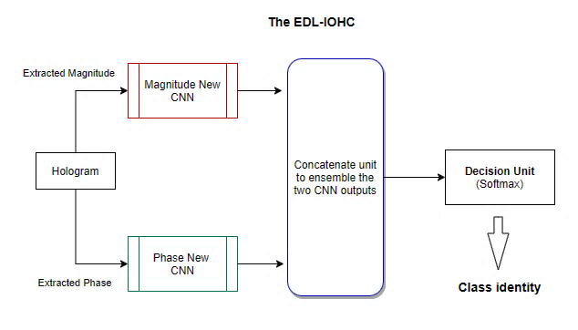
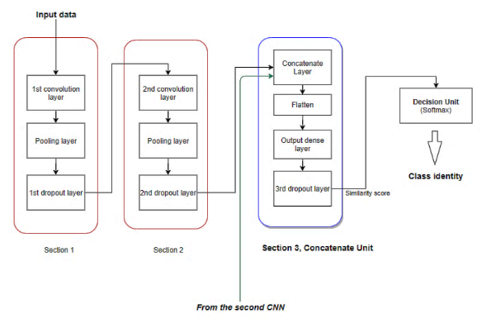
A Robust Wavefront Classifier, EDL-IOHC
C
H. H. LAM, P.W.M. Tsang and T.C. Poon, "Hologram Classification of Occluded and Deformable Objects with Speckle Noise Contamination by Deep Learning," Optical Society of America A, vol. 39, no. 3, 2022.

Slide 5
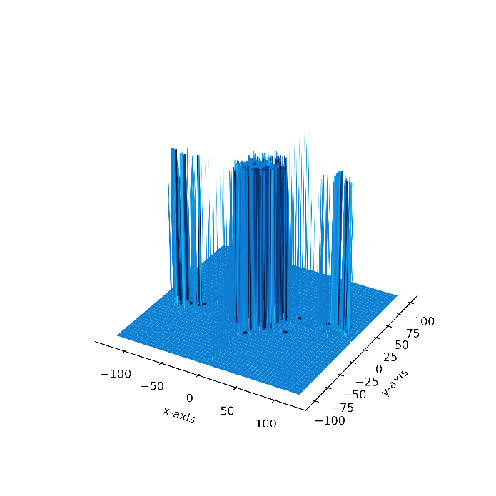
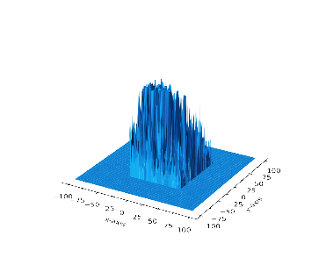
Frequency Spectrums
(a) Full spectrum frequency plot.
(b) Clipped spectrum frequency plot.

Slide 6
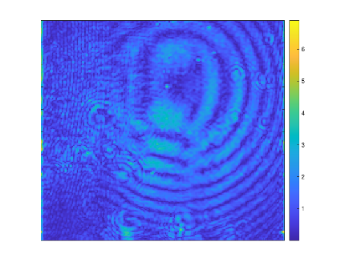
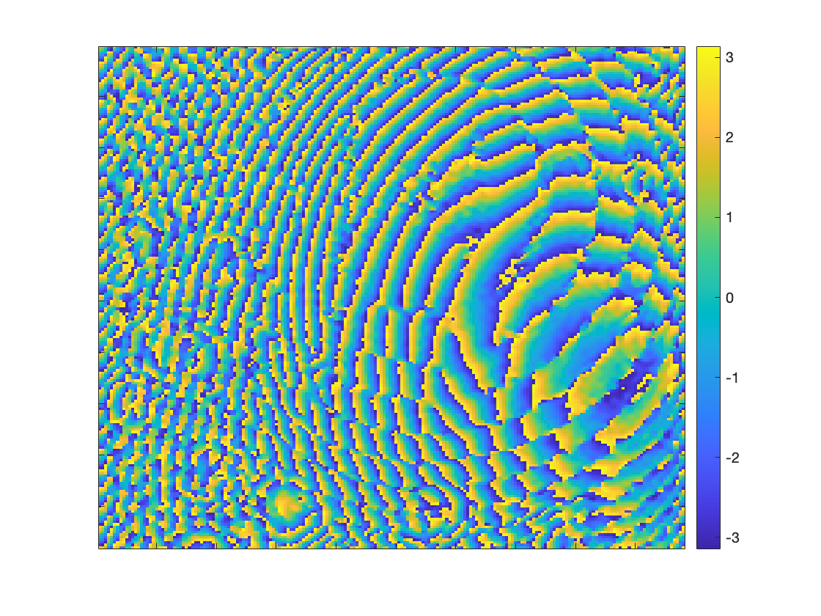
Magnitude and Phase Plots
(c) Magnitude Plot of the complex wavefront.
(d) Phase plot of the complex wavefront.
GGO. Ground Grass Texture/Opacity: M. Takeda, W. Osten, E. Watanabe. Holographic 3D Imaging through Random Media: Methodologies and Challenges. Page 2, Light: Advanced Manufacturing.

Slide 7
Experimental Evaluation and Results
* Optical parameters of the off-axis holographic interferometer.
Parameter | Value
Wavelength of light | 632.8 nm
Pixel size | 3.45 um
Size of Hologram | 2056 rows and 2546 columns
Off-axis angle | 1.5 degrees
Hologram Plane Distance | 0.1m
* Success rates for classifying the out-training test set and the complete data set by the
EDL-IOHC deep learning structure.
 | Success rate on the specimens
Out-training set | 99.60%
Complete set (both out and in training sets) | 99.82%

Slide 8
The EDL-IOHC (method C) is very effective in establishing a computational model to form decision boundaries for recognizing digital wavefronts.
Fully automatic;
Work under noisy conditions with occluded objects;
High recognition accuracy;
Almost no effort when applying from one domain to another similar domain.
By the new paradigm, complex wavefront recognition is feasible. In passing, we believe:
The magnitude-phase ensemble architecture can be generalized for EM waves governed similarly by the Maxwell Equations.
The applications in holography imaging are only a start.

Slide 9
Conclusions
All the results demonstrate that complex wavefront recognition is feasible by the new paradigm with the ensemble machine learning architecture.
The method effectively classifies digitized optical wavefront with high accuracy.
Direct wavefront analysis is a crucial new step to advancing similar research for oscillating wave phenomena, e.g., invisible light, other EM waves, or even ultrasound.

Slide 10
A key conclusion
From a broader perspective, electromagnetic wavefront classification and detail analysis are feasible by the machine learning method.
In passing, we believe the proposing EDL-IOHC can be taken as a reference framework and be extended to various remote sensing disciplines when complex wavefronts are involved (e.g., IR/UV waves governed by the Maxwell Equations).

Slide 11

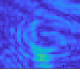
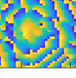

Slide 12
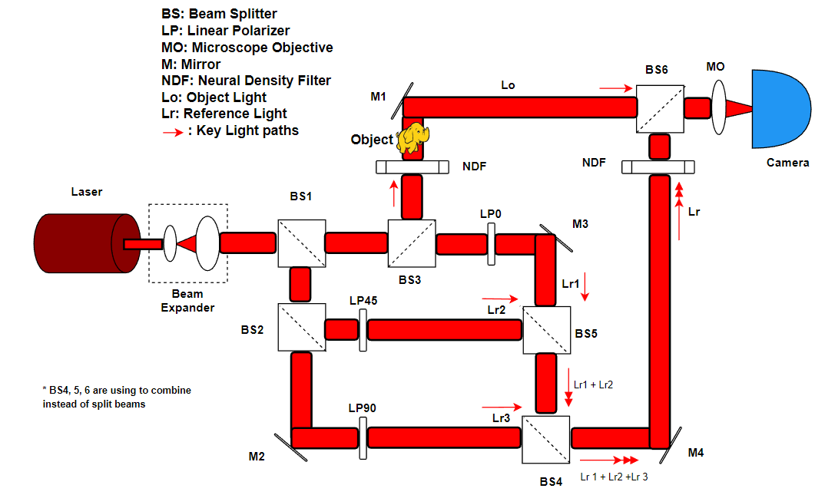


An interferometer:
[a] Y. Zhu, C. H. Yeung and E. Y. Lam, "Digital holography with polarization multiplexing for underwater imaging and descattering," in 2021 International Workshop on Metrology for the Sea; Learning to Measure Sea Health Parameters (MetroSea), 2021
[b] https://www.edmundoptics.com/knowledge-center/application-notes/optics/what-are-beamsplitters/

Slide 13
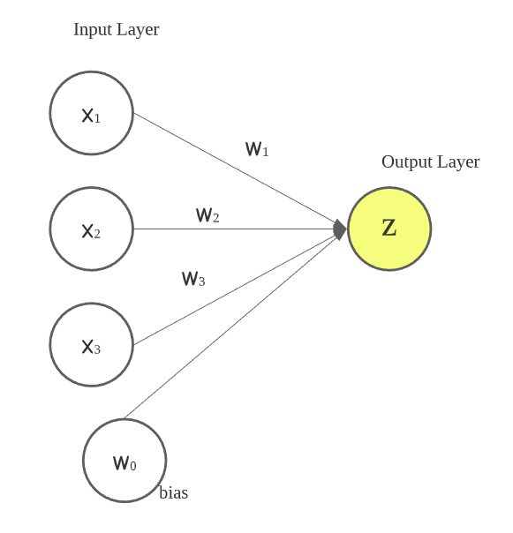

Deep Machine Learning - Perceptron
Artificial neuron attempts to model the information processing capabilities of nervous systems.
The neurons in the artificial neural network are formalized by numerical inputs and outputs by following linear equation, with additional non-linear output unit.
$z=w_{0}+w_{1}x_{1}+w_{2}x_{2}+w_{3}x_{3}$
where $w_{0}$ is the bias b
Dichotomy Method: Ancient Chinese philosophers I-Ching’s (Yijifng)

Slide 14
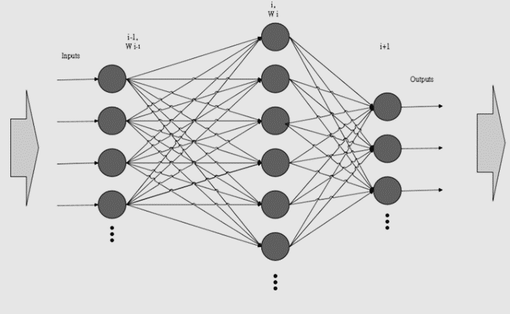

Deep Neural Network
A deep network becomes a hierarchical composite model where each layer applies a linear transformation followed by a nonlinear function to the preceding layer:
$𝓚\left({X,W}^{1}……W^{I}\right)={ ψ_{I}(ψ_{I−1}(……..ψ_{2}(ψ_{1}(XW}^{1}) W^{2})……… W^{I−1})W^{I}$)
where:
$X ∈ ℝ^{N x D}$ is input data
$W^{i}∈ℝ^{d_{i−1} x d_{i}}$ be a matrix representing a linear transformation applied to the output of a layer i-1, $X_{i−1} ∈ ℝ^{N x d_{i−1}}$, to obtain a $d_{i}$ dimensional representation $X_{i−1}W^{i} ∈ ℝ^{N x d_{i}}$ at layer i.
$ψ_{i}: ℝ→ℝ$ be a nonlinear activation function, e.g. a sigmoid $ψ_{i}\left(x\right)=$Rectified linear unit ReLU $ψ_{i}\left(x\right)=max⁡\{0, x\}$ .

